Slide 1
Overview of Machine Learning Systems
Challenges and Considerations in Applying Machine Learning
Student: Paulo Eduardo da silva Junior

Slide 2
Summary
When to Use Machine Learning?
Machine Learning Use Cases.
Research vs. Production in ML.
ML Systems vs. Traditional Software.
Conclusion.

Slide 3
When to Use Machine Learning?
Identifying complex, predictable patterns in data.
Advantage in predictive tasks such as recommendations and fraud detection.
Assessing need, ethics, and cost-benefit.
Machine learning is an approach to
Learn;
Complex patterns from;
Existing data and use these patterns to make;
Predictions on;
Unseen data.

Slide 4
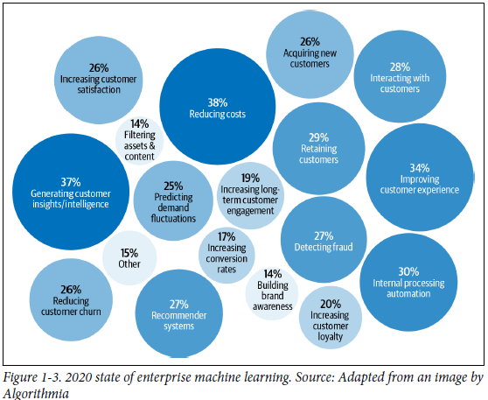
Machine Learning Use Cases
Industries:
Enterprise: Customer insights, process automation, anomaly detection.
End-user: Personal assistants, machine translation, image recognition.

Slide 5
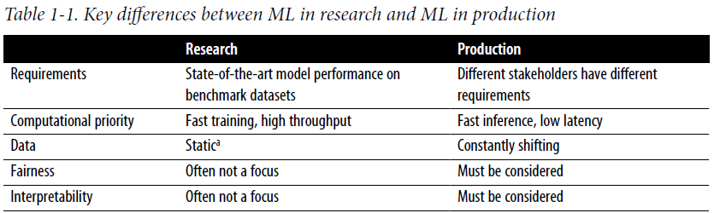
Research vs. Production in ML
Points:
Challenges in dynamic data and latency.
Need for interpretability and fairness.
Stakeholder demands: engineering, product management, and sales.

Slide 6
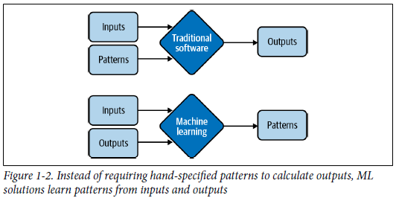
ML Systems vs. Traditional Software
Comparison:
ML: Dependence on data and models.
Traditional Software: Main dependence on code.
Challenges of adaptation, monitoring and maintenance in ML.

Slide 7
Conclusion
Summary:
The complexity of ML systems demands more than algorithms.
Infrastructure, monitoring, and maintenance are essential.
Future chapters will detail components for a complete ML system.

